Slide 1

Sprint 1 Group 37
08-05-2019 – 15-05-2019

Slide 2

This sprint we finished:
a 1st version class diagram
the (1st version) SQL local database
The user stories:
Seeing a list of todays bookings of a specific room
Showing alternative rooms on the tablet of an already booked room
Creating a booking for a specific room on the tablet if the room is free
On the server-side:
The implementation of API methods for specific rooms
The implementation of API methods to be called from the web interface

Slide 3
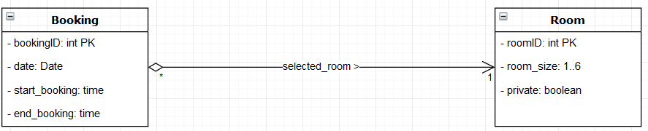
Class diagram

Slide 4
DEMO

